Slide 1
Reconstructing a Sanskrit text

Slide 2
1. Transcription
2. Alignment (collatio)
3. Building a tree (recensio)
4. Reconstructing a text (examinatio)

Slide 3
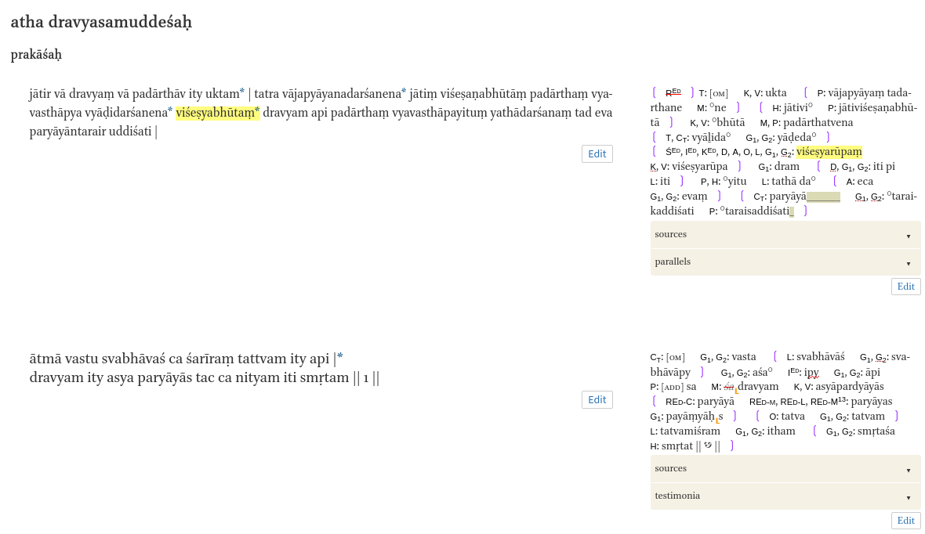
Transcription
saktumiva.org

Slide 4
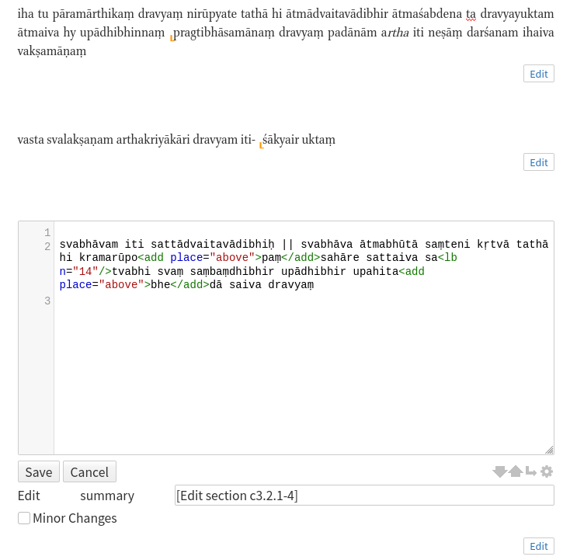
Transcription
saktumiva.org

Slide 5
Alignment
A v a s t u s v a r ū p - - - - - a m a r th a k r i y ā k ā r i d r a v y a ṃ
B v a s t a s v a l a k ṣ a - - n a - - - - - k r i y ā k ā r i d r a v y a ṃ
C v a s t u s v a l a k ṣ a m ā n a m a r th a k r i y ā k ā r i d r a v y a ṃ
A va stu sva rū pa - - ma rtha kri yā kā ri dra vyaṃ
B va sta sva la kṣa - na - - kri yā kā ri dra vyaṃ
C va stu sva la kṣa mā na ma rtha kri yā kā ri dra vyaṃ
A vastu svarūpam arthakriyākāri dravyaṃ
B vasta svalakṣanakriyākāri - dravyaṃ
C vastu svalakṣamānam arthakriyākāri dravyaṃ

Slide 6
Alignment
gap: -1
change: -1
v a s t u
v a s i -
v a s t u
v a s - i
1 change , 1 gap
score: -2
1 change , 1 gap
score: -2

Slide 7
Alignment
gap: -1
vowel -> vowel change: -1
consonant -> vowel change: -2
v a s t u
v a s i -
v a s t u
v a s - i
1 change , 1 gap
score: -3
1 change , 1 gap
score: -2

Slide 8
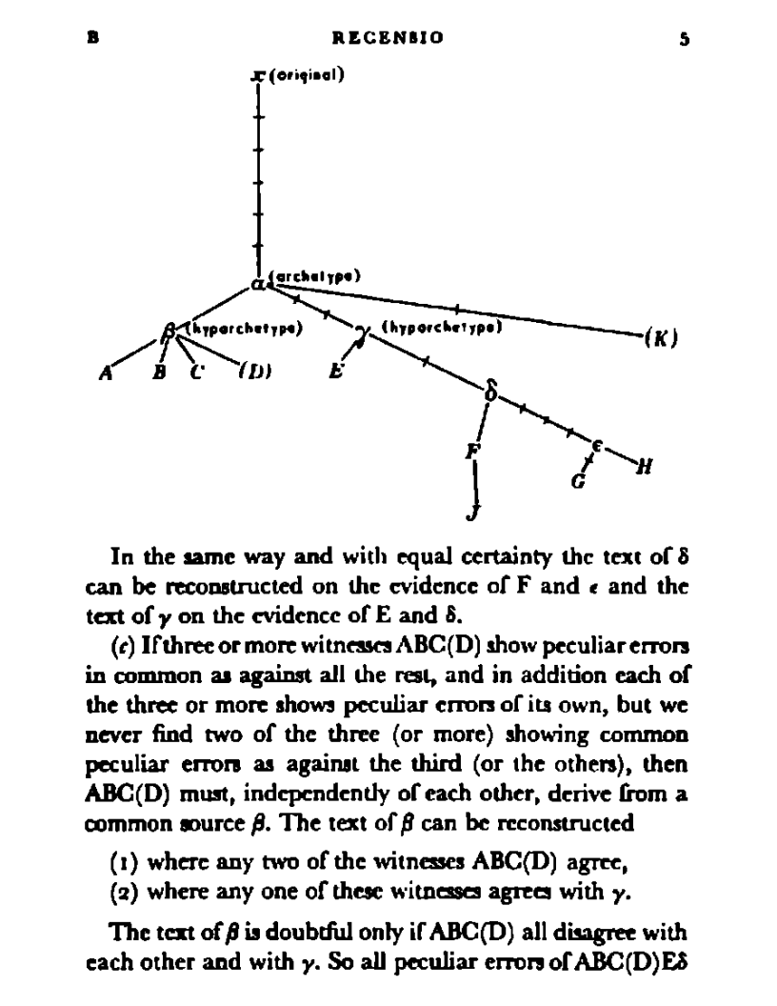
Building a tree
Maas 1958

Slide 9
Reconstructing a text
“Lachmann” method (Maas 1958)
“majority rule” (Pasquali, Trovato 2014)
Fitch’s algorithm

Slide 10
Reconstructing a text
rū rū rū la

Slide 11
Reconstructing a text
rū
{rū,la}
rū rū rū la

Slide 12
Reconstructing a text
rū
rū
{rū, la}
rū rū rū la

Slide 13
Reconstructing a text
rū
rū
{rū, la}
rū rū rū la

Slide 14
Multi-text alignment
A yasyeti he dhīrāḥ jñānadayāsindhoḥ jñānaṃ ca dayā ca tayoḥ sindhor guṇāḥ
B he dhīrāḥ yasya guṇāḥ jñānaṃ ca dayā ca tayoṣ sinduḥ
C he dhīrāḥ vidvāṃsaḥ jñānadayayoḥ sindhur iva sindhus yasya guṇāḥ

